Slide 1





School: ............................................................................................................. Campus: .......................................................
Academic Year: ...................... Subject Name: ........................................................... Subject Code: ..........................
Semester: ............... Program: ........................................ Branch: ......................... Specialization: .......................... Date: .....................................
(Learning by Doing and Discovery)
ECDSA Workshop – Digital Signatures Demo
* Coding Phase: Pseudo Code / Flow Chart / Algorithm
ALGORITHMS:
Study the concept of ECDSA (Elliptic Curve Digital Signature Algorithm) and how it ensures transaction authenticity.
Learn about private key and public key generation, and how the public key is mathematically derived from the private key using elliptic curve multiplication.
Explore the digital signature process — how a transaction is signed with a private key and verified with a public key.
Observe how ECDSA secures Bitcoin transactions by allowing others to verify ownership without revealing the private key.
Take notes on the full form of ECDSA, its role in Bitcoin, and the verification steps.
* Softwares used
Text editor
Web Browser

Slide 2
Applied and Action Learning
* Implementation Phase: Final Output (no error)
What is ECDSA?
ECDSA stands for Elliptic Curve Digital Signature Algorithm.
It is a cryptographic algorithm used to create and verify digital signatures.
In blockchain systems like Bitcoin and Ethereum, ECDSA ensures that:
Only the rightful owner of a private key can sign a transaction.
Anyone can verify that the signature is valid using the corresponding public key.
ECDSA is based on elliptic curve mathematics, which provides high security with smaller key sizes compared to traditional algorithms like RSA.
Key Points
Private key: A secret number used to create signatures.
Public key: Derived from the private key; used by others to verify signatures.
Digital signature: A unique code that proves a message or transaction was created by the owner of the private key.
Used in blockchain: To sign transactions and confirm ownership without revealing the private key.
Example (in simple terms)
You create a Bitcoin transaction and sign it using your private key (ECDSA).

Slide 3
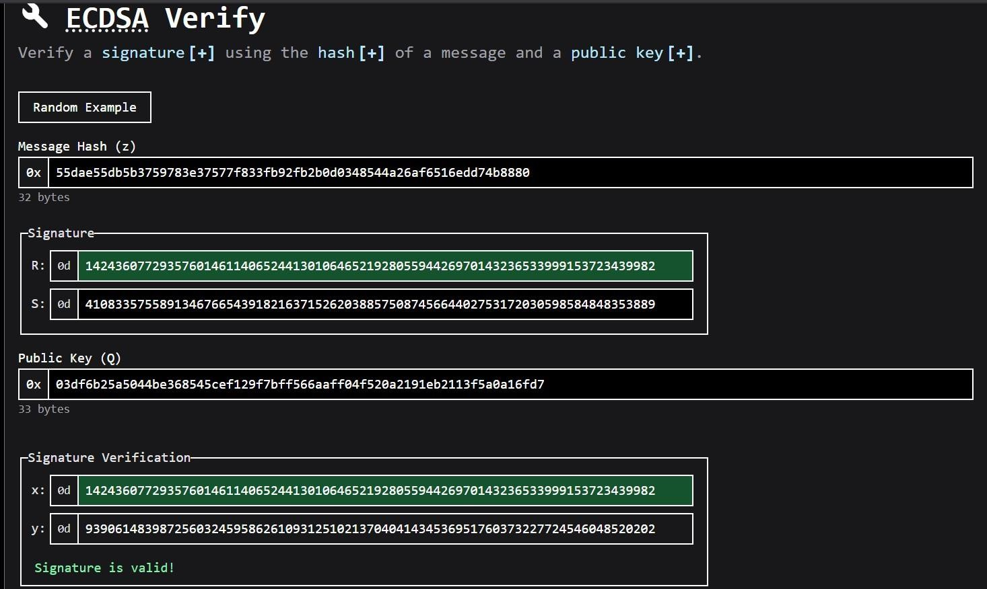

* Implementation Phase: Final Output (no error)
Applied and Action Learning
* Observations
ECDSA is a public-key cryptographic algorithm used for digital signatures.
It ensures authentication, integrity, and non-repudiation of messages or transactions.
Based on elliptic curve cryptography (ECC), it provides the same security as RSA but with smaller key sizes.
Rubrics
Concept | 10
Planning and Execution/ Practical Simulation/ Programming | 10
Result and Interpretation | 10
Record of Applied and Action Learning | 10
Viva | 10
Total | 50
Signature of the Student:
Signature of the Faculty:

